Slide 1
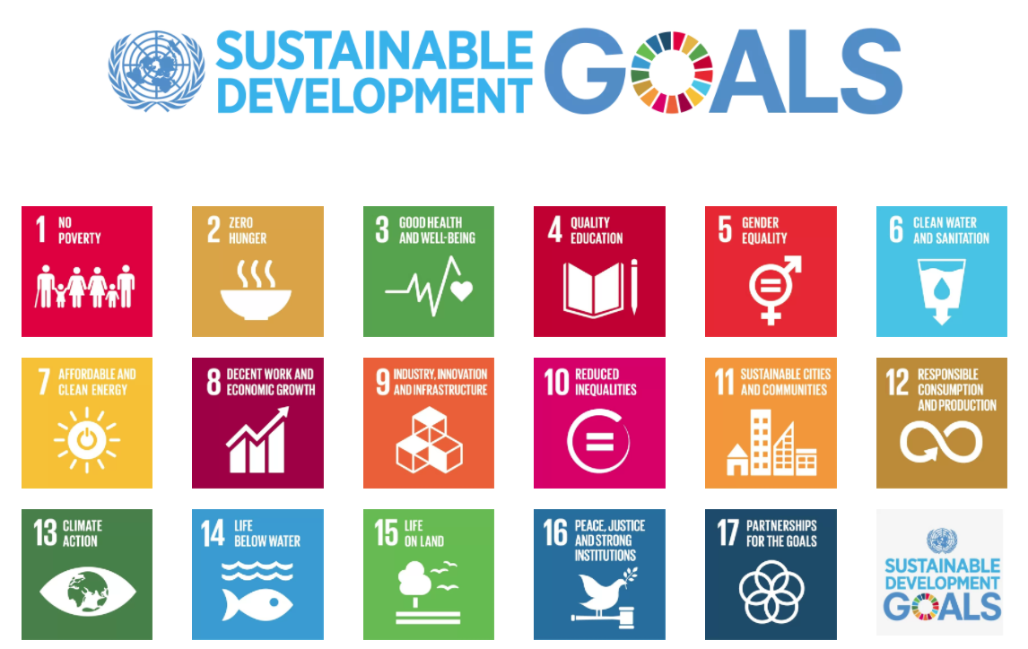
2015 to 2030
Notes:
On 1 January 2016, the 17 Sustainable Development Goals (SDGs) of the 2030 Agenda for Sustainable Development — adopted by world leaders in September 2015 at an historic UN Summit — officially came into force. Over the next fifteen years, with these new Goals that universally apply to all, countries will mobilize efforts to end all forms of poverty, fight inequalities and tackle climate change, while ensuring that no one is left behind.
http://www.un.org/sustainabledevelopment/development-agenda/

Slide 2

At least 1.8 billion people use a source of drinking water contaminated with feces
More than 80% of wastewater is discharged without any pollution removal

Slide 3

SDG 6.1: By 2030, safe and affordable drinking water for all
Some three in ten people (2.3 billion) lack access to safe and readily available water at home (not clear if this is a guess or is based on data)
Additional 1.2 billion from population growth gives 3.5 billion need water by 2030
267 million people per year! (1 Indonesia/year)
At 3 mL/s per person we need 800,000 L/s per year of new installed capacity
Notes:
http://www.un.org/sustainabledevelopment/blog/2017/07/billions-around-the-world-lack-safe-water-proper-sanitation-facilities-reveals-un-report/

Slide 4
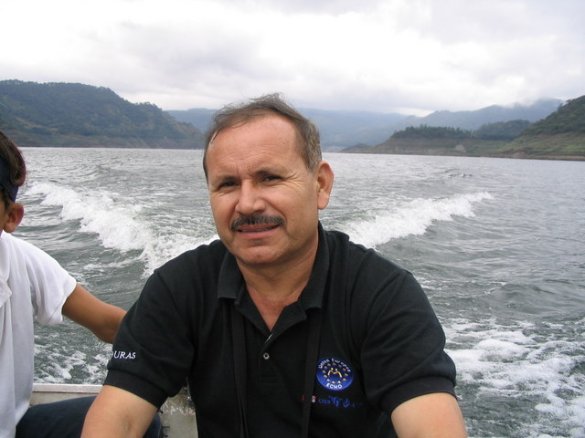
What can we do to treat the dirty water that we are providing to rural communities?
Notes:
What can we do to treat the dirty water that we are providing to rural communities?

Slide 5
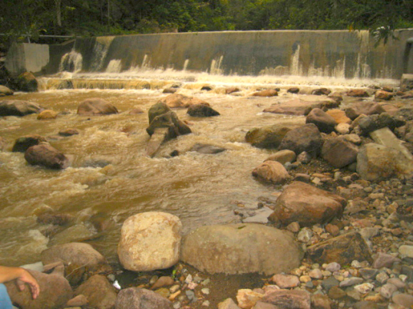
What is the Problem?
River water on tap (at the kitchen sink) is common in Latin America
High turbidity especially during the rainy season
Pathogens from surface runoff and from upstream settlements
High incidence of diarrhea among children and adults

Slide 6
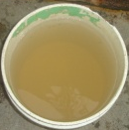
What is it like to have river water on tap?
To wash dishes, clothing, children?
To try to keep your children healthy when the water is full of pathogens?
This is why we are developing better technologies for making safe water on tap!

Slide 7
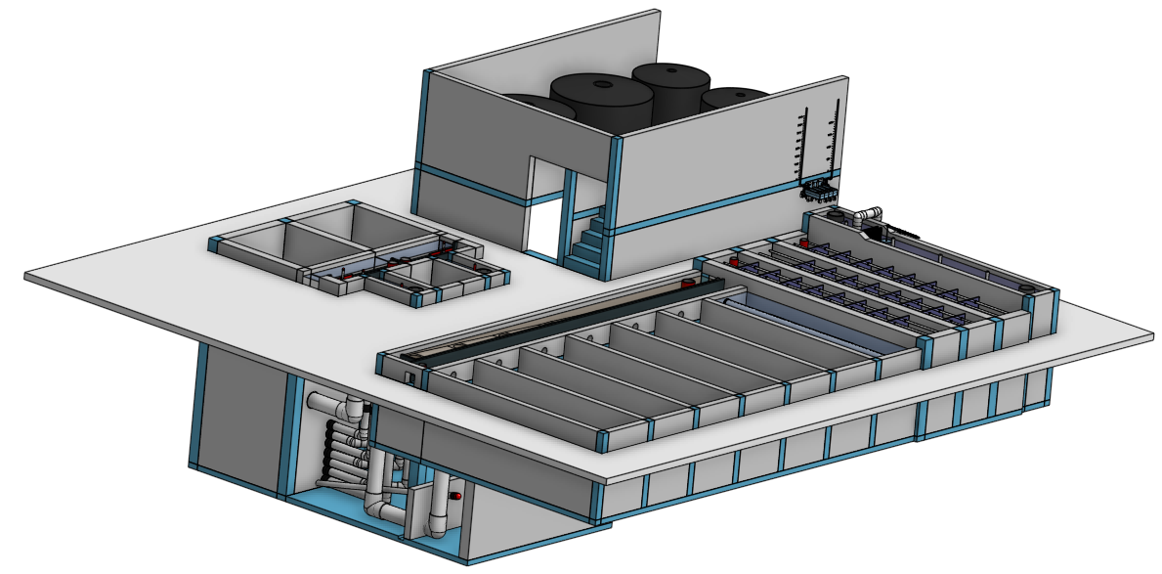
What did we learn?

Slide 8
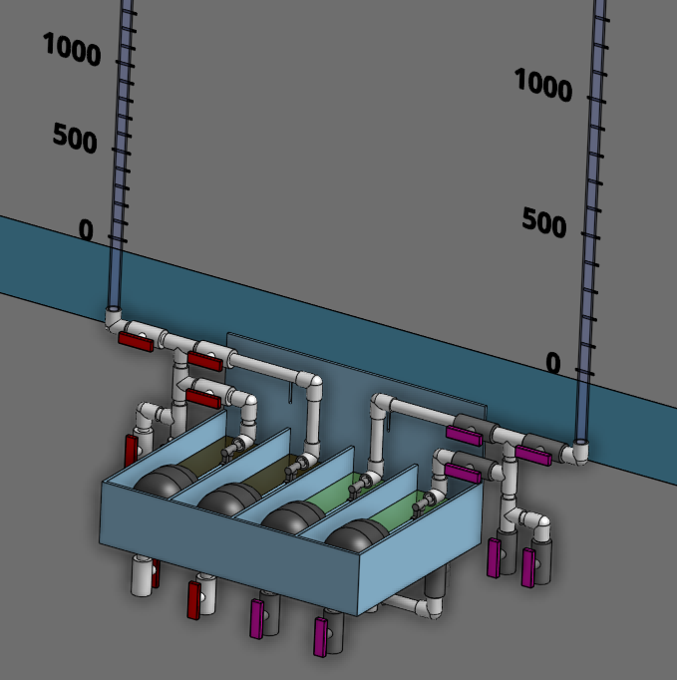
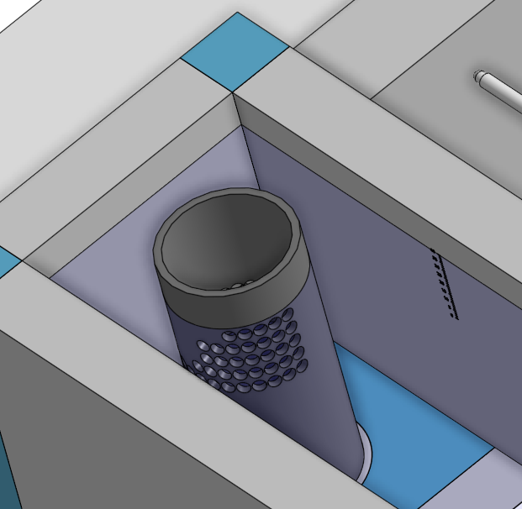
Flow Control and Measurement
We need constant chemical level to get constant flow
Dosing tubes (laminar flow, long, straight) provide a linear relationship between potential energy input and flowrate
Linear Flow Orifice Meters provide an easy linear relationship between flowrate and water level

Slide 9
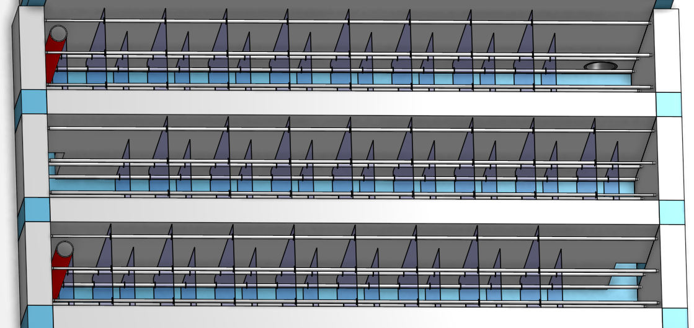
Flocculation
Potential Energy is converted to Kinetic Energy in flow contractions
Kinetic Energy is converted into heat by viscosity. On the way it deforms the fluid
As the fluid is deformed it causes relative motion between particles and particle collisions
Gt is a measure of the total fluid deformation
Design the flow dimensions to get the target velocity gradient

Slide 10
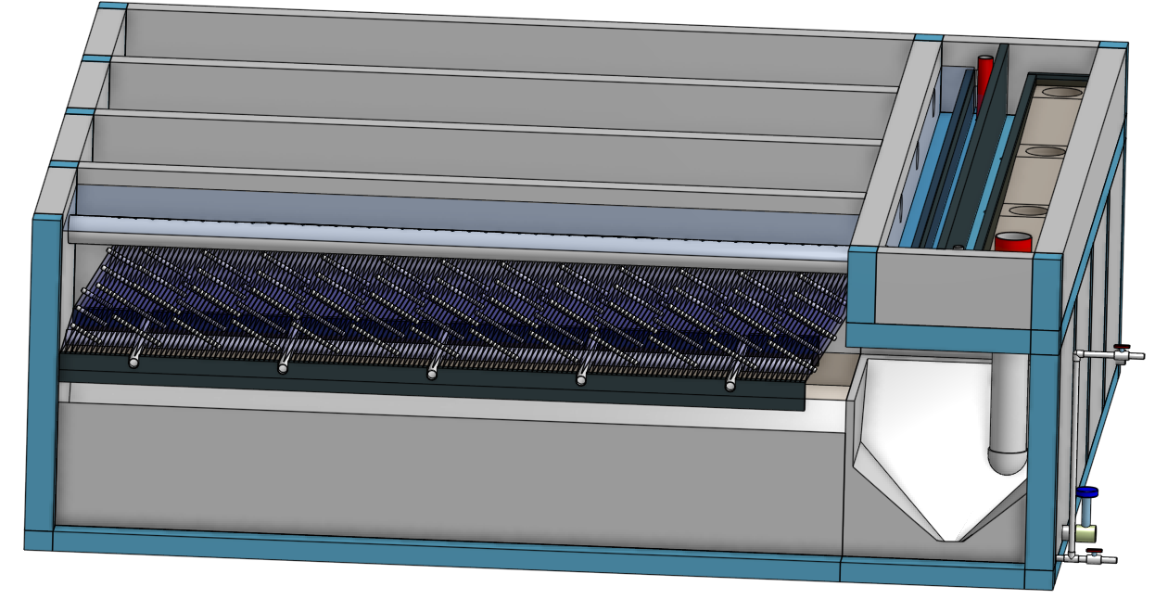
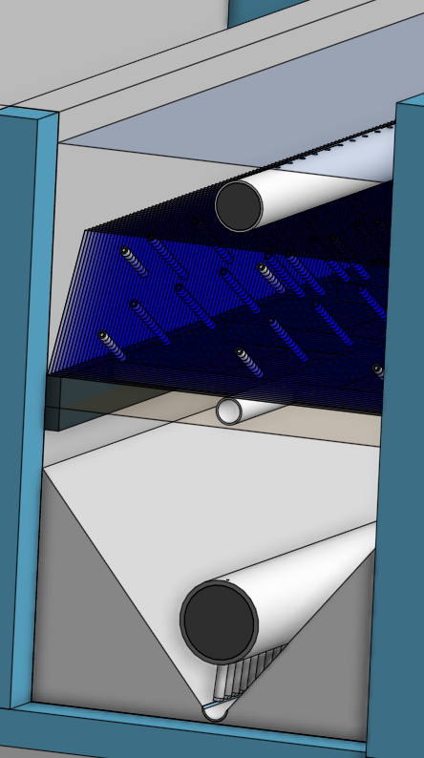
Clarification
Diffusers and jet reverser keep floc filter fluidized
Flocs in the floc filter capture small particles that failed to flocculate
Excess flocs flow into the floc hopper
Particles that settle faster than the plate settler capture velocity are converted into larger flocs by the plate settlers (and returned to the floc filter)

Slide 11
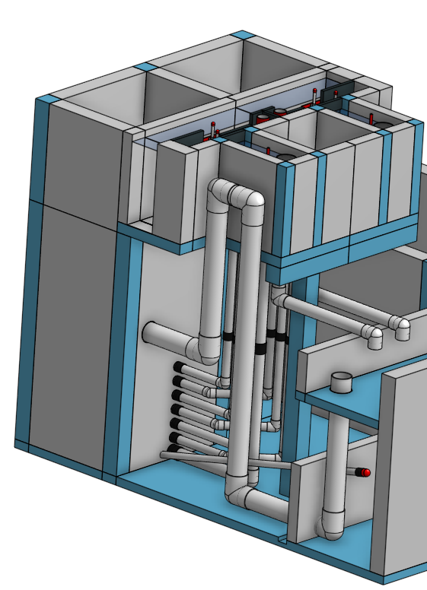
Filtration (for clean water)
Larger flocs that attach to the constricted part of a pore…
…are filters that capture small particles
The flocs have a finite capacity to capture small particles
Constrictions don’t clog. They reach a stable minimum diameter where the shear exceeds the coagulant bond strength
The active filtration zone moves deeper and deeper into the filter until it “breaks through” and filter performance worsens

Slide 12
Zoom out one step!
Parametric design
Insight that humans have much to learn about how the universe works
Technology matters
Multipliers
US drinking water treatment infrastructure

Slide 13
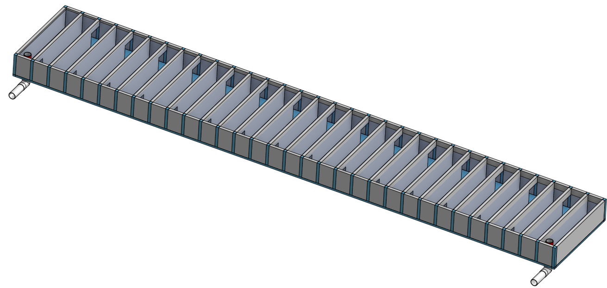
You learned the power of parametric design
Codify the logic of the design
Create the general solution rather than a specific solution
Now you have a tool that can create customized designs
If you learn that there are additional constraints you can change the configuration or the logic to capture the new constraints and develop a whole new set of designs

Slide 14
Parametric Design could be applied to many engineering challenges
Wastewater treatment plant design
Bridge design
Home design
Solar farm design
Windmill design
Any design!

Slide 15
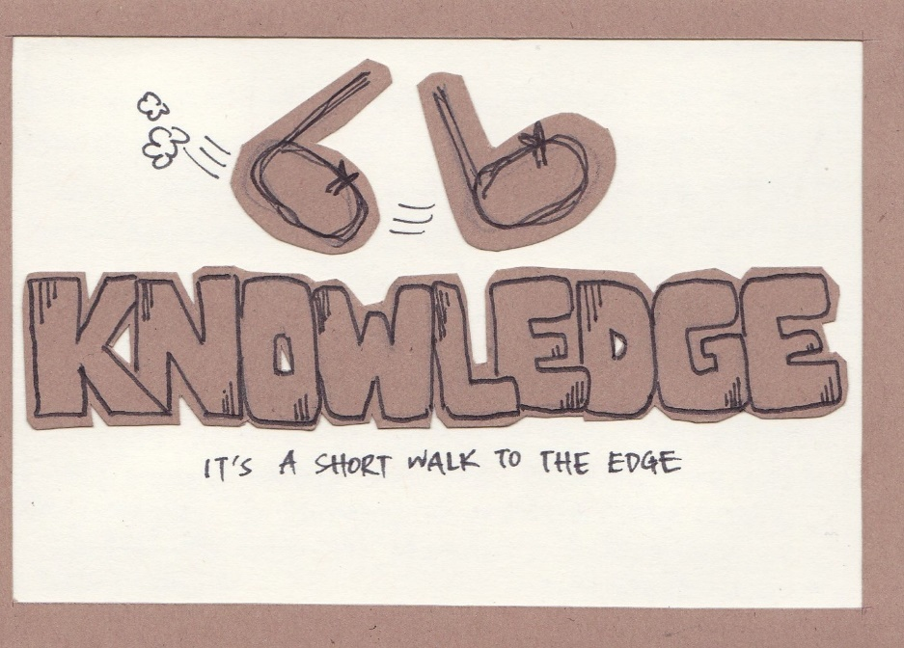
The edge of knowledge is very near (We have major gaps in our knowledge!)
We want to encourage skepticism and we want to develop insights to guide thoughtful skepticism. A key skill for successful engineering is the ability to identify the location of the edge of knowledge. – from The Physics of Water Treatment Design
There are MANY opportunities to improve
drinking water treatment technologies
Floc filters
Sand filters
water treatment plant operation
Coagulant dosing

Slide 16
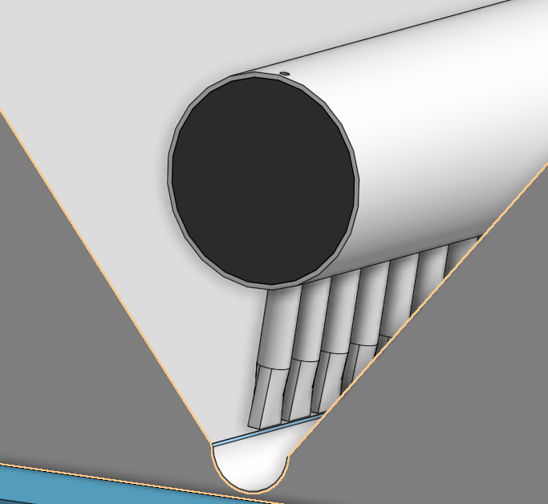
Use the scientific method to test hypotheses
Yesterday’s conversation with Minty Nuñez
Should we assemble one of the clarifier manifolds without tapering the diffusors?
YES!
We can compare performance of the clarifiers and see which system works best

Slide 17
Useful Technology IS an Undervalued Factor
By visiting water treatment plants in Honduras, Colombia, Ethiopia, India, and Nepal it became clear that technology IS a major reason for water system failures
People are willing to pay for services that they value
No one likes to pay for terrible service (river water on tap is terrible service)!
If the cost of delivering better service is less than the increase in willingness to pay, then improving the service will lead to a more stable system!
Better service can be MUCH more sustainable!!!!!!
Notes:
Useful Technology is POWERFUL

Slide 18
These factors are multipliers!!!!
1x1x1x1x1x0=0
Energy x Education x Money x Governance x Labor x Technology = ?
1x1x½x1x1x2=1
Notes:
You can sometimes compensate for poor engineering by providing more inputs
Energy – fossil fuels
Education
Money
Management
Labor
You can sometimes reduce this burden on society by improving the technologies
These factors are multipliers!!!!

Slide 19
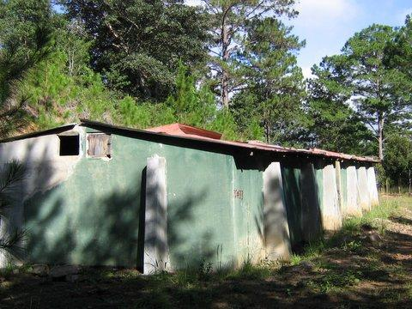
How we talk about failed interventions reflects our world view
“The community didn’t maintain their water filter plant.”
What does this statement imply?
Do you think the community leaders made a rational decision?
Why do you think the community didn’t maintain their water treatment plant?
Notes:
But most of the time the pump breaks down within a few years, by which time I’ll have moved on to another project in another country. Another NGO or another project manager will take over where I left off, and the cycle continues.
Each time we repeat the cycle, we believe optimistically our response will work. We falsely attribute the breakdown of a pump to poor government policies, corrupt local officials or weak management by the water-user committee.
https://www.theguardian.com/global-development-professionals-network/2017/apr/07/clean-water-everyone-sdg-failure

Slide 20
Why do you think the community didn’t maintain their water treatment plant?
They didn’t value clean water
No mechanism in place to fund operation and maintenance
Too expense to operate
Too hard to clean the filter
Cleaning the filter requires too much water
They weren’t trained how to clean the filter
The filter doesn’t clean the water

Slide 21
US Water Infrastructure
ASCE Drinking Water grade is C-
What you’ve learned in this course is completely applicable to designing new and upgrading existing water treatment infrastructure anywhere on this planet
You have the latest insights into the core water treatment processes – the only course on the planet that teaches this material!

Slide 22
Resilient Designs are needed in the United States too! (fewer interdependent systems are better)
NYC blackout of 1977
Boeing Max 8 substituted a stable aeronautic design for software feedback control (a 20 billion dollar mistake)
Design for steady state (cruising at flight elevation) is easy
Design for rapid startup after disasters (with disrupted supply chains) is much harder
Using Computers to manipulate valves to set flows using feedback control results in poor performance in many “modern” water treatment plants
Notes:
Manual operation fully enabled (Max 8 lesson)
Use physics rather than software to enable reliable operation
Smart hydraulics (example of StaRS flow control system)
https://theaircurrent.com/aviation-safety/what-is-the-boeing-737-max-maneuvering-characteristics-augmentation-system-mcas-jt610/
By moving the larger and more fuel efficient engine slightly forward and higher up they increased fuel efficiency by 14%
Caused an increased moment on the aircraft causing it to tend to rotate the nose up.
Connect water treatment plant design to Max 8 aircraft.
Separate control and monitoring

Slide 23
Mechanized Water Treatment Plants could be improved by using Hydraulic Controls
Computerized controls have real difficulties doing simple things like equally dividing flow between filters and maintaining steady flow
Computerized controls require experts to tune the algorithms and maintain the hardware and software
Hydraulic controls can be easily designed to reliably accomplish those goals (set it and forget it)
Hydraulic controls are inherently stable, resilient, don’t require electricity, and can be adjusted and maintained by plant staff

Slide 24
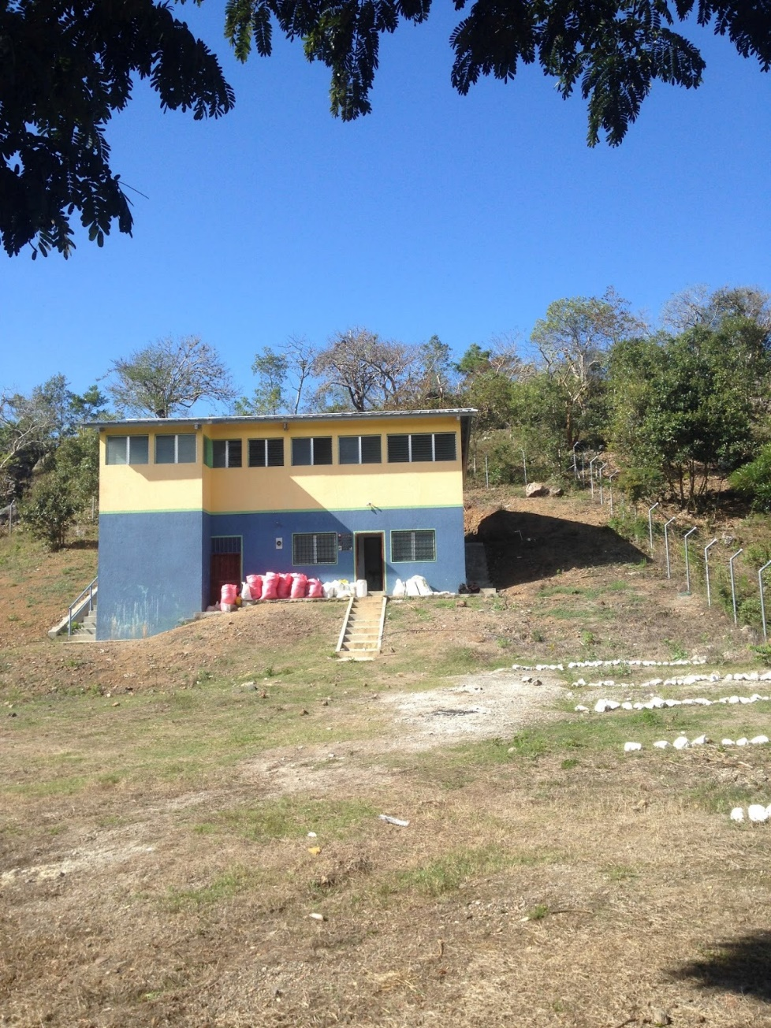
November, 2019: A Rural Water Workshop In Honduras
APP engineer, Santiago Garcia, presented the AguaClara technology
Workshop participants went to visit the AguaClara plant at Jesús de Otoro
Pedro Ortiz, Honduran government water engineer, stated that the only group in Latin America that is investigating low cost water treatment is AguaClara: “la mejor en el mundo”

Slide 25
Connecting Meaning to Graduate School and Professional Careers
Four steps toward a better world
Measure stuff (often sufficient for a Ph.D.)
Create models of how our universe works (based on observations) (fundamental science)
Invent new solutions based on good models of how our universe works (inventing!)
Engage with the world to implement those solutions (engineering!)
Our planet needs bold engineers and scientists who engage to create a better world
Engaging with real world problems facilitates inventions
Notes:
You can get a Ph.D. doing step 1 sometimes.
Step 2 is great for getting a Ph.D.
Steps 3 and 4 are much harder!

Slide 26
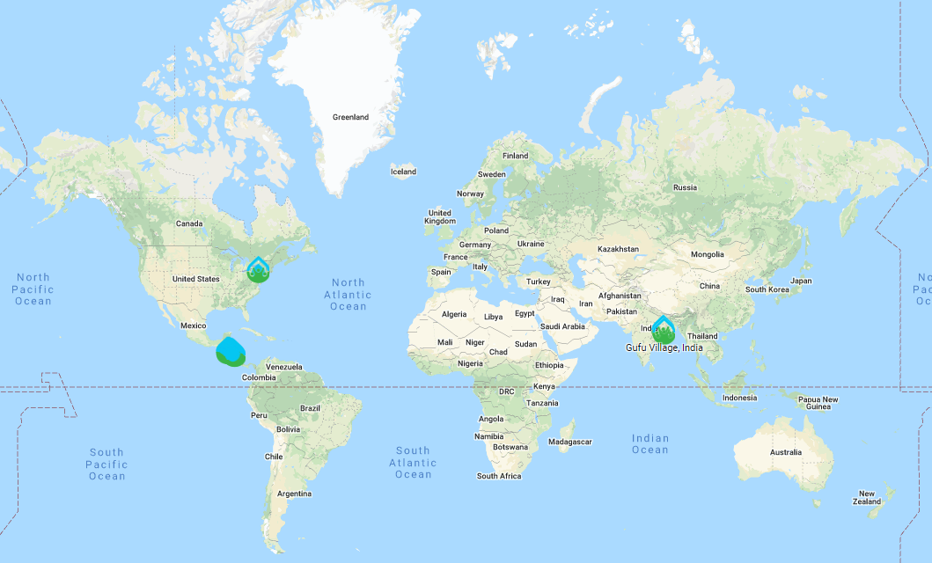
AguaClara 23 towns – 86,000 people

Slide 27
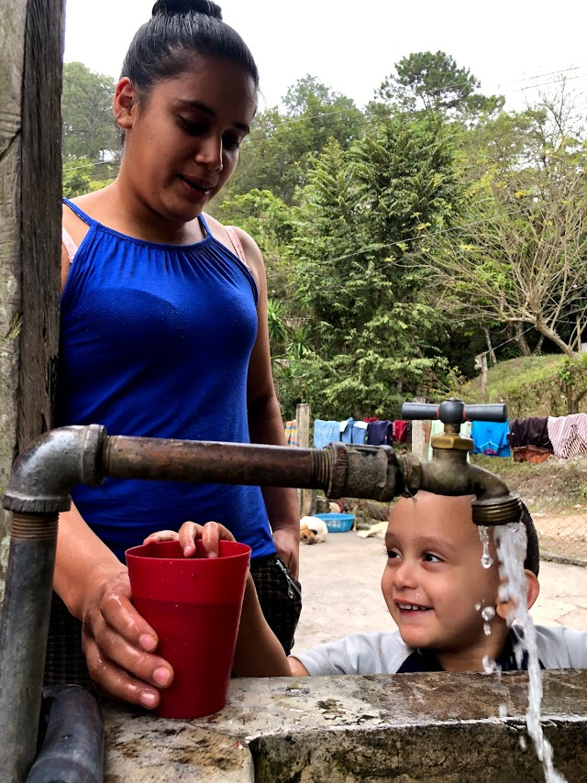
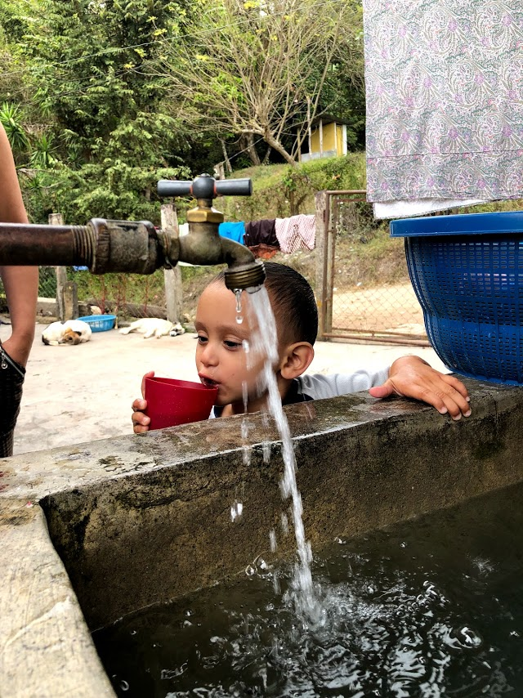
Happiness is safe water on tap

Slide 28
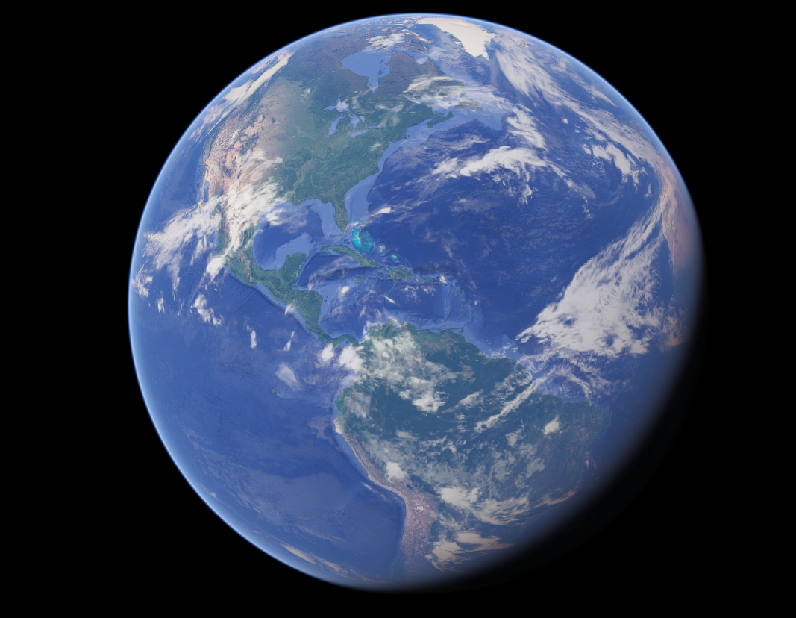
Engineering is Love
Notes:
Engineering makes it possible for people to live AND THRIVE in communities
Helping others to thrive is the definition of love
Putting it all together, Engineering is love!

Slide 29
Thank you!
A big thank you to Patrick Sours and Michael Hagenburger for creating the dream of an AguaClara program at OSU
Special thanks to Patrick for making teaching easy by handling all of the administrative and logistical details
Special thanks to Clare for making this first Onshape version of SWOT a success (and for providing feedback and guidance)
Thank you to all of the students for being willing to take the risk of a new course
…and for working hard to learn lots of new material!

